Slide 1


Applied ML for veterinary epidemiologists
ISVEE pre-conference workshop - Day 4
Session 2 – Neural network fundamentals
Dr Tom Brownlie
Notes:
How important is biosecurity in other countries?

Slide 2

Machine learning is turning things (data) into numbers and finding patterns in those numbers.
The computer does this part. How?
Code & math.
We’re going to be writing the code.

Slide 3

Why use machine learning
(or deep learning)?

Slide 4
What is deep learning?

Slide 5



Traditional programming
inputs
Cut vegetables
Season chicken
Preheat oven
Cook chicken for 30-minutes
Add vegetables
Outputs
makes
ML/DL approach
inputs
Outputs
Cut vegetables
Season chicken
Preheat oven
Cook chicken for 30-minutes
Add vegetables
figures out

Slide 6
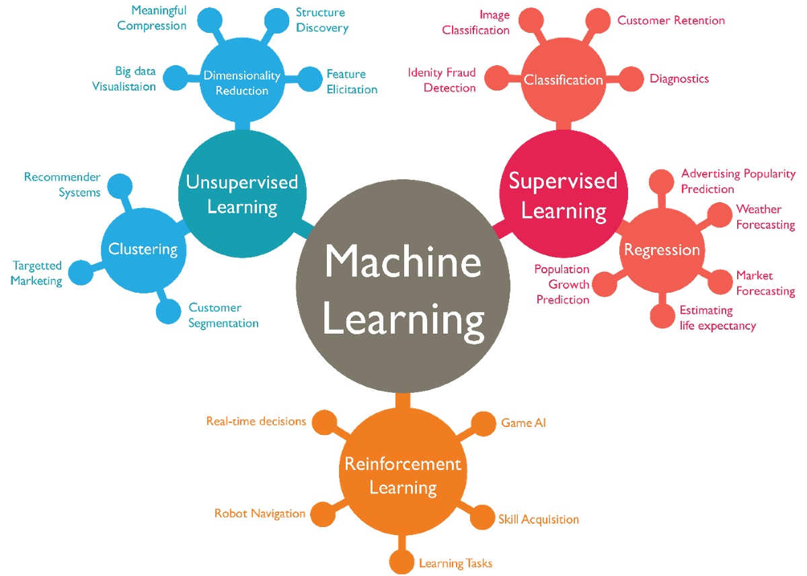

Family trees

Slide 7

Deep Learning with

Slide 8

What is PyTorch?
Most popular research deep learning framework
Writes fast deep learning code in Python (and supports GPU runtimes)
Able to access many prebuilt deep learning models (TorchHub etc.)
Whole stack. Preprocesses data, models data, deploys to applications/cloud
Originally designed in-house by Meta. Now open sourced and used by Tesla, Microsoft and OpenAI etc.

Slide 9
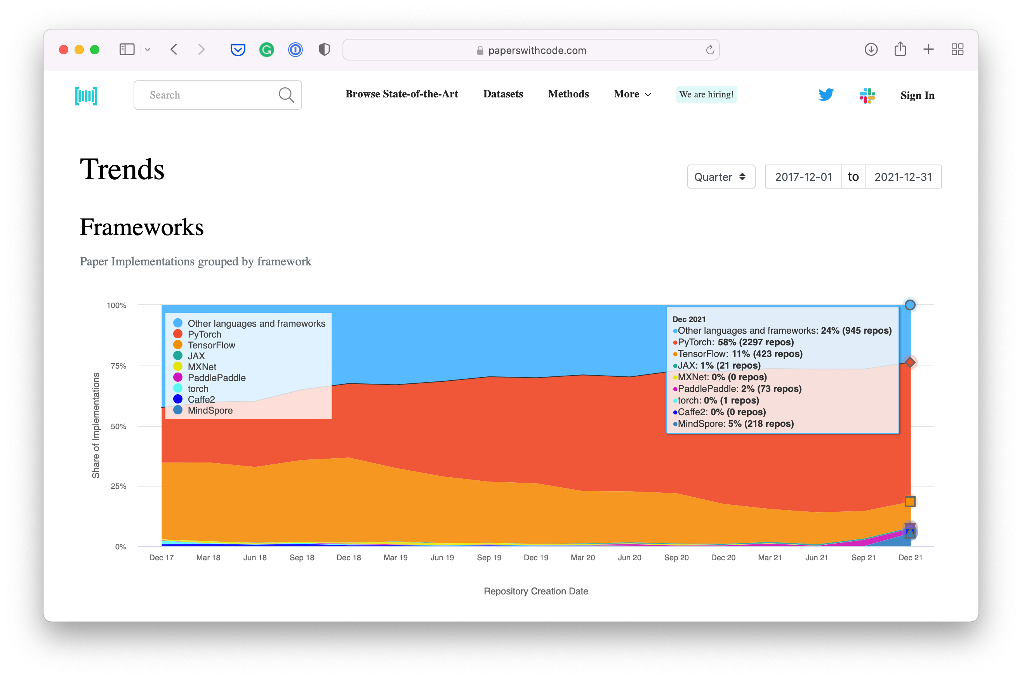
Why PyTorch?
paperswithcode.com/trends February 2022

Slide 10
What is a tensor?

Slide 11
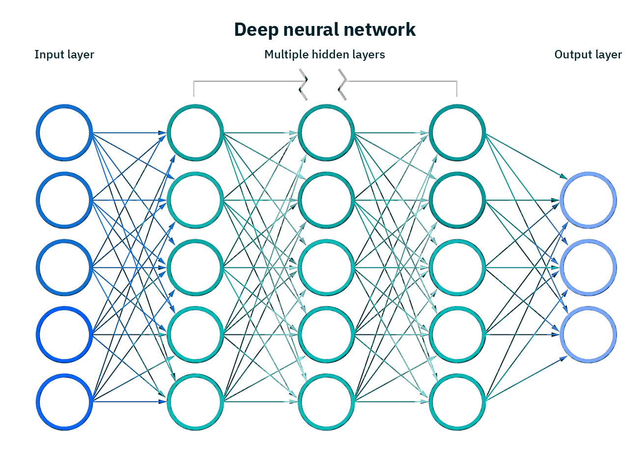




What are neural networks?
Inputs
Numerical encoding
Learns representations
(patterns, features, weights)
Representation outputs
Outputs
1. Cut veg…
[[116, 78, 15],
[117, 43, 96],
[125, 87, 23],
…,
[[0.983, 0.004, 0.013],
[0.110, 0.889, 0.001],
[0.023, 0.027, 0.985],
…,
Hey Siri, what’s the weather today?
Ramen spagetti
These are tensors
Notes:
Chat – describe tensors

Slide 12
What are neural networks?
Inputs
Numerical encoding
Learns representations
(patterns, features, weights)
Representation outputs
Outputs
[[116, 78, 15],
[117, 43, 96],
[125, 87, 23],
…,
[[0.983, 0.004, 0.013],
[0.110, 0.889, 0.001],
[0.023, 0.027, 0.985],
…,
1. Cut veg…
These are tensors

Slide 13
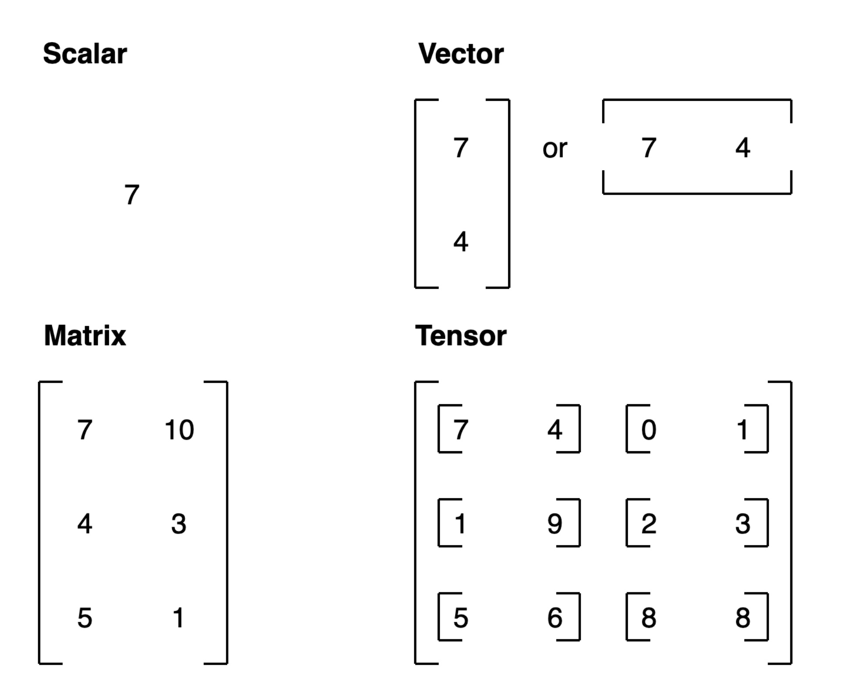
What is a tensor?
A generalization of vectors and matrices to higher dimensions.
Notes:
• Scalar: A single number or value, representing one quantity. Think of it as a point, like temperature or weight—just one thing with no dimensions.
• Vector: A one-dimensional array, like a list of numbers. Each number represents a direction or position along one axis. For example, a vector can store the speed and direction of wind, where each entry is related but distinct in meaning.
• Matrix: A two-dimensional array, often visualized as a grid or table with rows and columns. Each entry represents a value at the intersection of these two dimensions. Matrices are powerful for representing relationships and transformations, like in image processing where each cell might represent a pixel’s color intensity.
• Tensor: A generalization of vectors and matrices to higher dimensions. Tensors allow us to represent multi-dimensional data, such as a stack of images over time (three dimensions: height, width, and time). Tensors are essential for complex data structures, especially in machine learning.

Slide 14
Tensor dimensions
tensor([[[1, 2, 3],
[3, 6, 9],
dim=0
[2, 4, 5]]])
Dimension (dim)
0 1 2
tensor([[[1, 2, 3],
0
1
dim=1
[3, 6, 9],
torch.Size([1, 3, 3])
[2, 4, 5]]])
2
tensor
([[[1, | 2, | 3],
[3, | 6, | 9],
[2, | 4, | 5]]])
0 | 1 | 2
dim=2

Slide 15
Matrix multiplication (dot product)
A | B | C
D | E | F
G | H | I
J | K
L | M
N | O
A*J + B*L + C*N | A*K + B*M + C*O
D*J + E*L + F*N | D*K + E*M + F*O
G*J + H*L + I*N | G*K + H*M + I*O
torch.matmul(
,
)
3x3 3x2
Numbers on the inside must match
3x2
New size is same as outside numbers
5 | 0 | 3
3 | 7 | 9
3 | 5 | 2
4 | 7
6 | 8
8 | 1
5 | 0 | 3
44 | 38
126 | 86
58 | 63
torch.matmul(
,
)
* * *
 | 4 | 6 | 8
= = =
3x3
3x2
20 + 0
+ 24 =
3x2
44
For a live demo, checkout www.matrixmultiplication.xyz

Slide 16
Supervised learning
1. Initialise with random weights
2. Show examples
[[116, 78, 15],
[117, 43, 96],
[125, 87, 23],
…,
[[0.983, 0.004, 0.013],
[0.110, 0.889, 0.001],
[0.023, 0.027, 0.985],
…,
1. Cut veg…
3. Update representation outputs
4. Repeat with more samples

Slide 17
Tensor attributes
Attribute | Meaning | Code
Shape | The length (number of elements) of each of the dimensions of a tensor. | tensor.shape
Rank/dimensions | The total number of tensor dimensions. A scalar has rank 0, a vector has rank 1, a matrix is rank 2, a tensor has rank n. | tensor.ndim or tensor.size()
Speci<c axis or dimension (e.g. “1st axis” or “0th dimension”) | A particular dimension of a tensor. | tensor[0], tensor[:, 1]…

Slide 18
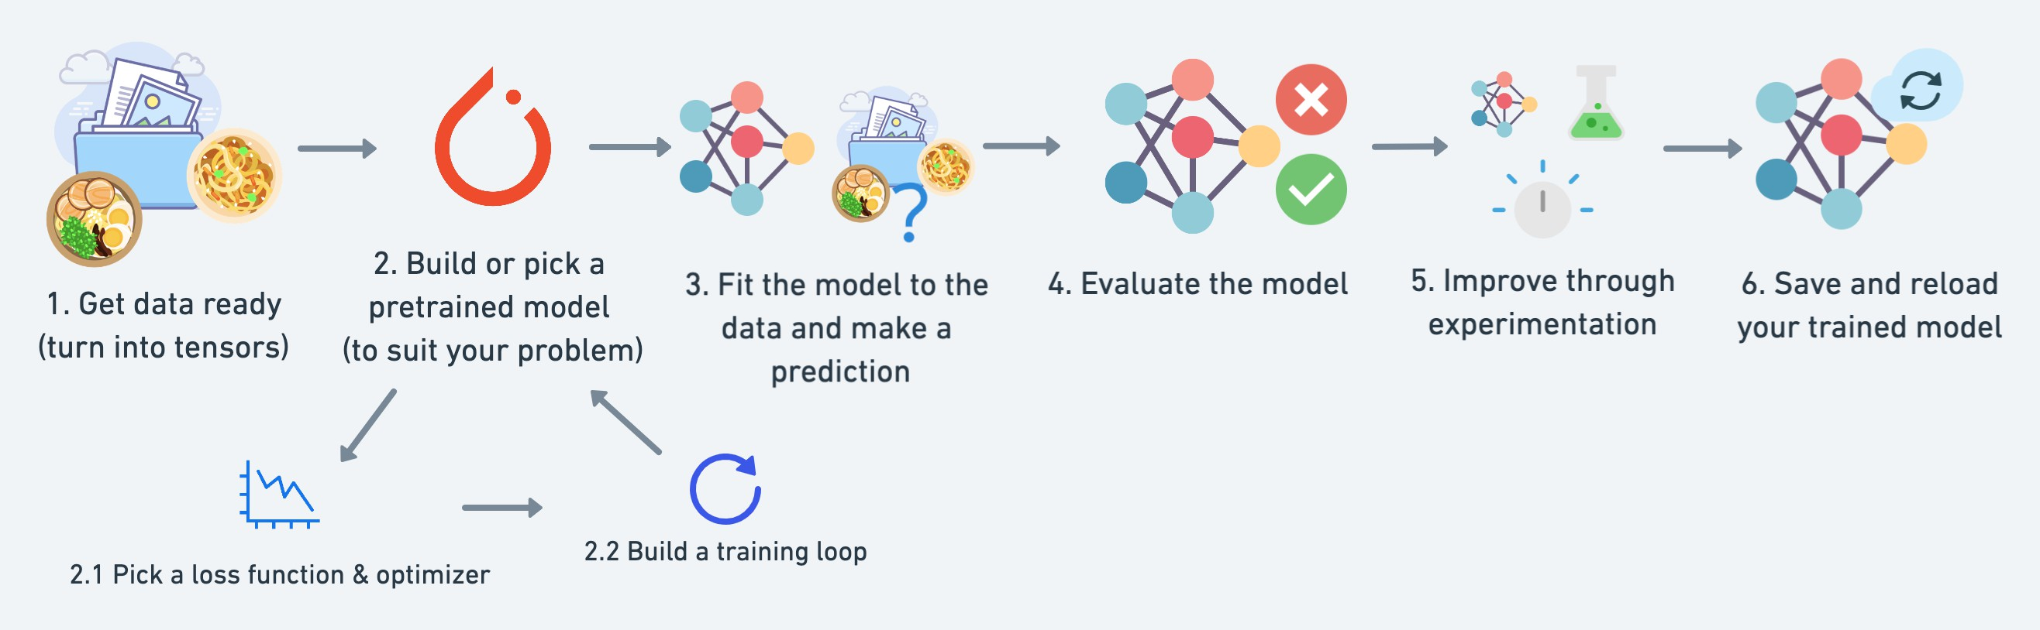
What are we going to cover?
Source https://github.com/mrdbourke/pytorch-deep-learning

Slide 19



Resources
Course tutors
Google’s in-built native LLM
https://pytorch.org/
Notes:
First time that we have run this content and unsure of timing

Slide 20
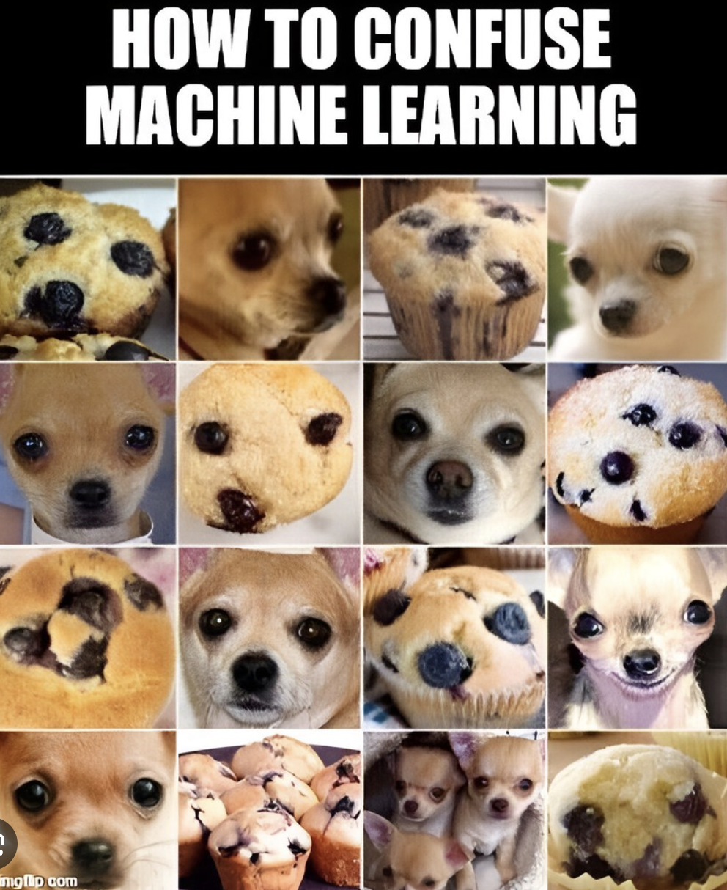

Slide 21
print("Let's Code”)
https://github.com/ingenum-ai/ISVEE_deepLearning_2024/
Open Notebook 2…
Notes:
Update github URL link to notebook and session 1.

